Slide 1
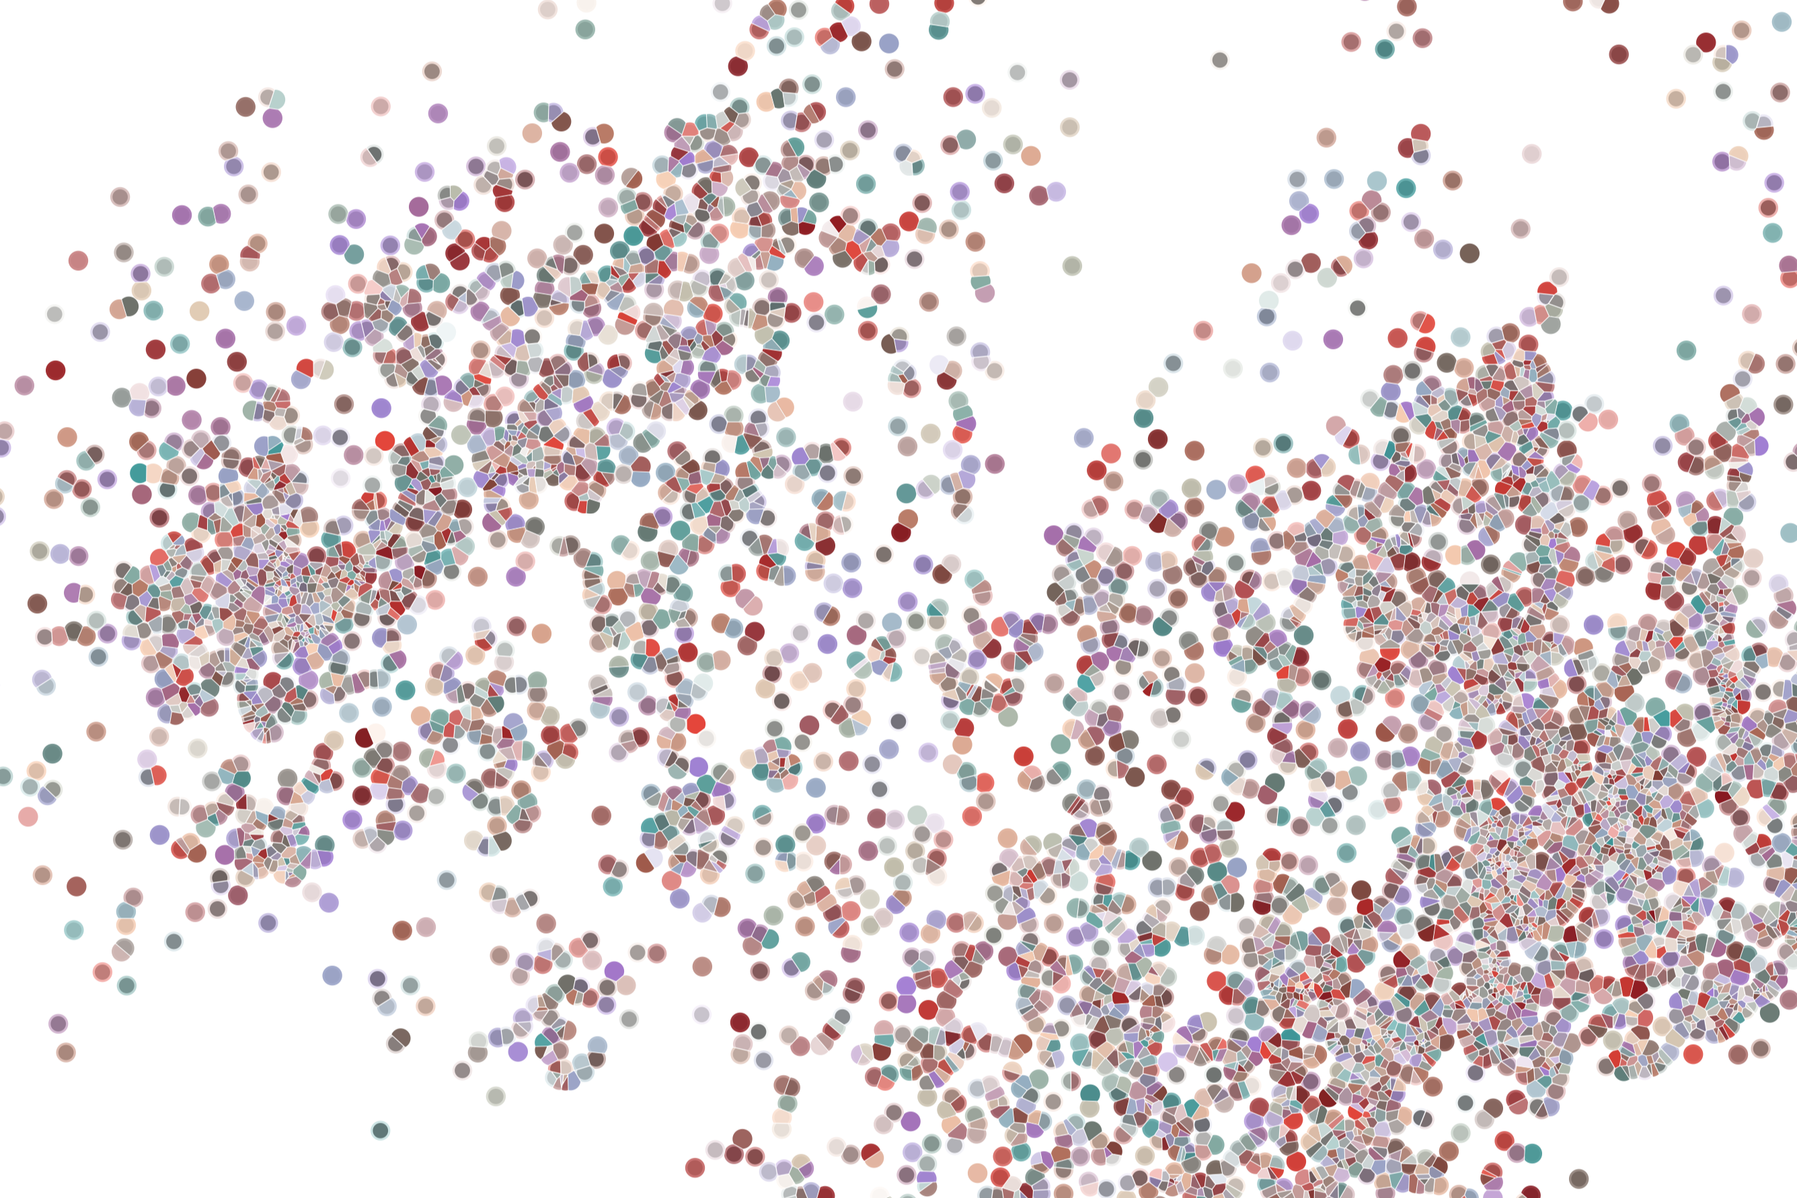
Lecture 5 scRNAseq analysis in R
Physalia course 2021 — Single-cell RNA-seq with R/Bioconductor
Instructors: Jacques Serizay
Notes:
Hello everybody and thank you for attending my presentation. I am going to talk about the project I recently started working on in the Spassky and Koszul labs, both located in Paris. This project focuses on the unusual cooption of the mitotic machinery to drive, not cell division but cell differentiation.

Slide 2

Genomics in R: relying on Bioconductor infrastructure
What do you need in bioinformatics to study genomics?
Most common genomic files:
BED format: essentially a set of chromosomal ranges
BigWig format: essentially veeeeeeeee…eeeeery long numerical vectors
Fasta format: letters, letters, letters
Others (bam, GFF, …): can usually be described/built on as one of the two options above
Notes:
I would like to expand these observations to in vivo data. I also want to check what happens in terms of transcriptional dynamics in cells where Cyclin O, a key non-canonical cyclin involved in MCC diff., is knocked-out.

Slide 3
Genomics in R: relying on Bioconductor infrastructure
Bioconductor
Free, open-source repository
Open development software project
Based primarily on the statistical R programming language
Bioconductor’s releases are bi-annual
Provides tools for the analysis and comprehension of genomic data
https://www.bioconductor.org/
Notes:
I would like to expand these observations to in vivo data. I also want to check what happens in terms of transcriptional dynamics in cells where Cyclin O, a key non-canonical cyclin involved in MCC diff., is knocked-out.

Slide 4
Genomics in R: relying on Bioconductor infrastructure
Bioconductor
Install it:
install.packages("BiocManager")
Notes:
I would like to expand these observations to in vivo data. I also want to check what happens in terms of transcriptional dynamics in cells where Cyclin O, a key non-canonical cyclin involved in MCC diff., is knocked-out.

Slide 5
Genomics in R: relying on Bioconductor infrastructure
Bioconductor
Use it:
install.packages("BiocManager")
require("BiocManager")
## Loading required package: BiocManager
## Bioconductor version 3.13 (BiocManager 1.30.16), R 4.1.1 (2021-08-10)
Notes:
I would like to expand these observations to in vivo data. I also want to check what happens in terms of transcriptional dynamics in cells where Cyclin O, a key non-canonical cyclin involved in MCC diff., is knocked-out.

Slide 6
Genomics in R: relying on Bioconductor infrastructure
Bioconductor
Bioconductor version is locked to R version:
install.packages("BiocManager")
require("BiocManager")
## Loading required package: BiocManager
## Bioconductor version 3.13 (BiocManager 1.30.16), R 4.1.1 (2021-08-10)
Notes:
I would like to expand these observations to in vivo data. I also want to check what happens in terms of transcriptional dynamics in cells where Cyclin O, a key non-canonical cyclin involved in MCC diff., is knocked-out.

Slide 7
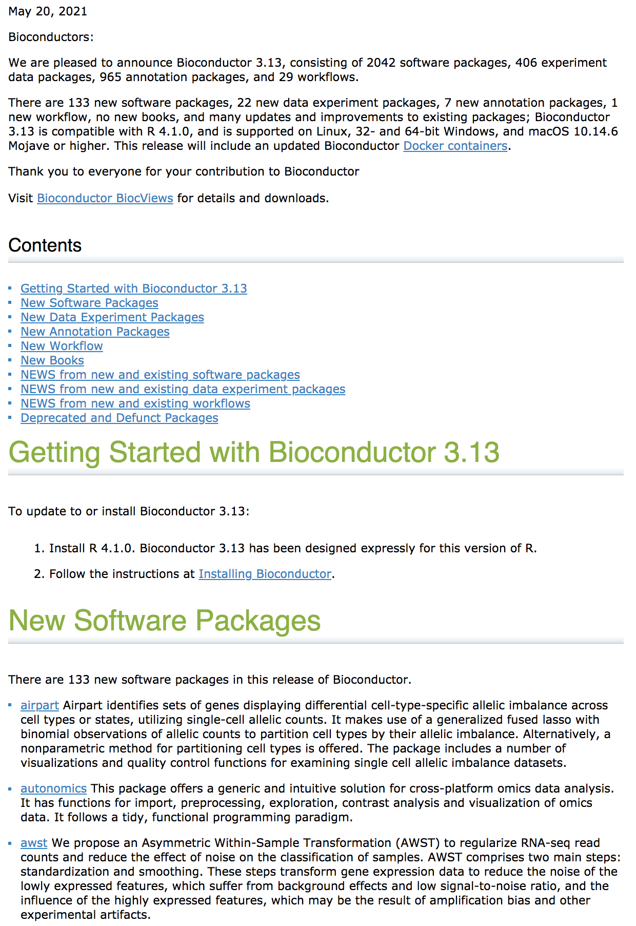
Genomics in R: relying on Bioconductor infrastructure
Bioconductor
Some packages are only available in newer Bioconductor releases.
Notes:
I would like to expand these observations to in vivo data. I also want to check what happens in terms of transcriptional dynamics in cells where Cyclin O, a key non-canonical cyclin involved in MCC diff., is knocked-out.

Slide 8
Genomics in R: relying on Bioconductor infrastructure
Bioconductor
Installing Bioconductor packages:
BiocManager::install("Biostrings")
BiocManager::install(c("GenomicRanges”, "rtracklayer"))
Notes:
I would like to expand these observations to in vivo data. I also want to check what happens in terms of transcriptional dynamics in cells where Cyclin O, a key non-canonical cyclin involved in MCC diff., is knocked-out.

Slide 9
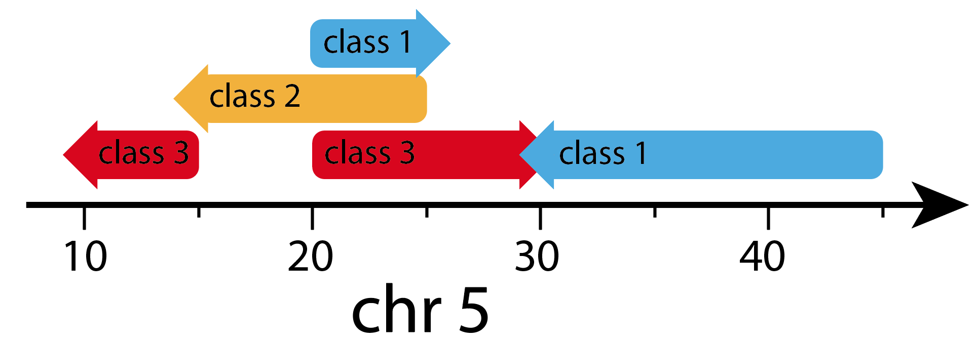
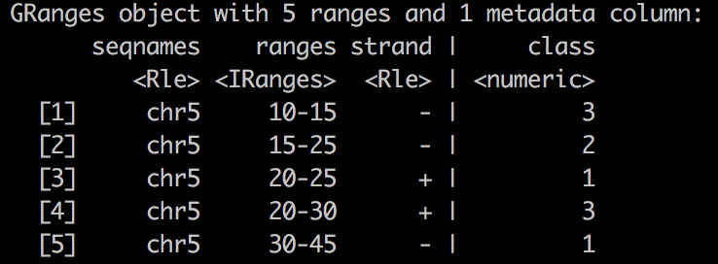
Bioconductor essentials
GenomicRanges
A way to represent genomic intervals in R
starts <- c(10 , 15 , 20 , 20 , 30 )
ends <- c(15 , 25 , 25 , 30 , 45 )
strands <- c('-' , '-' , '+' , '+' , '-' )
classes <- c(3 , 2 , 1 , 3 , 1 )
GRanges(
seqnames = 'chr5',
ranges = IRanges(start = starts, end = ends),
strand = strands,
class = classes
)
Notes:
I would like to expand these observations to in vivo data. I also want to check what happens in terms of transcriptional dynamics in cells where Cyclin O, a key non-canonical cyclin involved in MCC diff., is knocked-out.

Slide 10
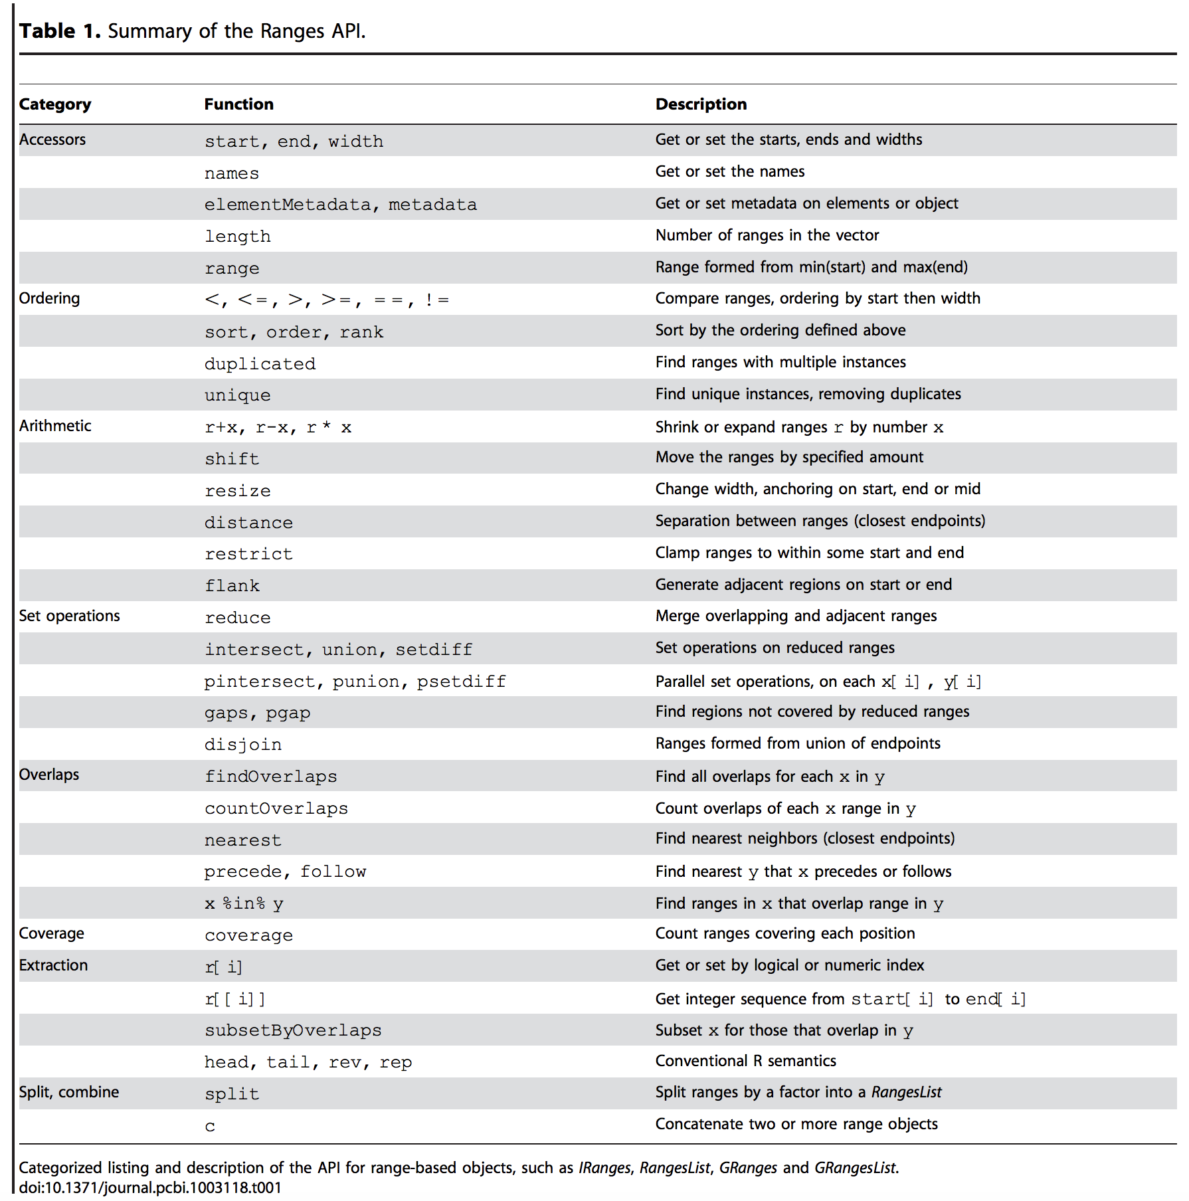
Bioconductor essentials
GenomicRanges
Allows efficient manipulation of genomic annotations and alignments in high-throughput data
Notes:
I would like to expand these observations to in vivo data. I also want to check what happens in terms of transcriptional dynamics in cells where Cyclin O, a key non-canonical cyclin involved in MCC diff., is knocked-out.

Slide 11
Bioconductor essentials
SummarizedExperiment
Allows efficient storage of genomic assays (e.g. raw read counts) over a set of features (e.g. gene loci).
Fundamental for most genomic-wide assays (ChIP-seq, RNA-seq, ATAC/MNase/DNase-seq, CNV, SNPs, VCF, Hi-C, …)
Cornerstone of genomic assays summarization within R
https://www.bioconductor.org/packages/devel/bioc/vignettes/SummarizedExperiment/inst/doc/SummarizedExperiment.html
Notes:
I would like to expand these observations to in vivo data. I also want to check what happens in terms of transcriptional dynamics in cells where Cyclin O, a key non-canonical cyclin involved in MCC diff., is knocked-out.

Slide 12
Bioconductor essentials
SummarizedExperiment
Allows efficient storage of genomic assays (e.g. raw read counts) over a set of features (e.g. gene loci).
Fundamental for most genomic-wide assays (ChIP-seq, RNA-seq, ATAC/MNase/DNase-seq, CNV, SNPs, VCF, Hi-C, …)
Structure more and more re-employed in R and outside (cf. Seurat, Loom, …)
Notes:
I would like to expand these observations to in vivo data. I also want to check what happens in terms of transcriptional dynamics in cells where Cyclin O, a key non-canonical cyclin involved in MCC diff., is knocked-out.

Slide 13
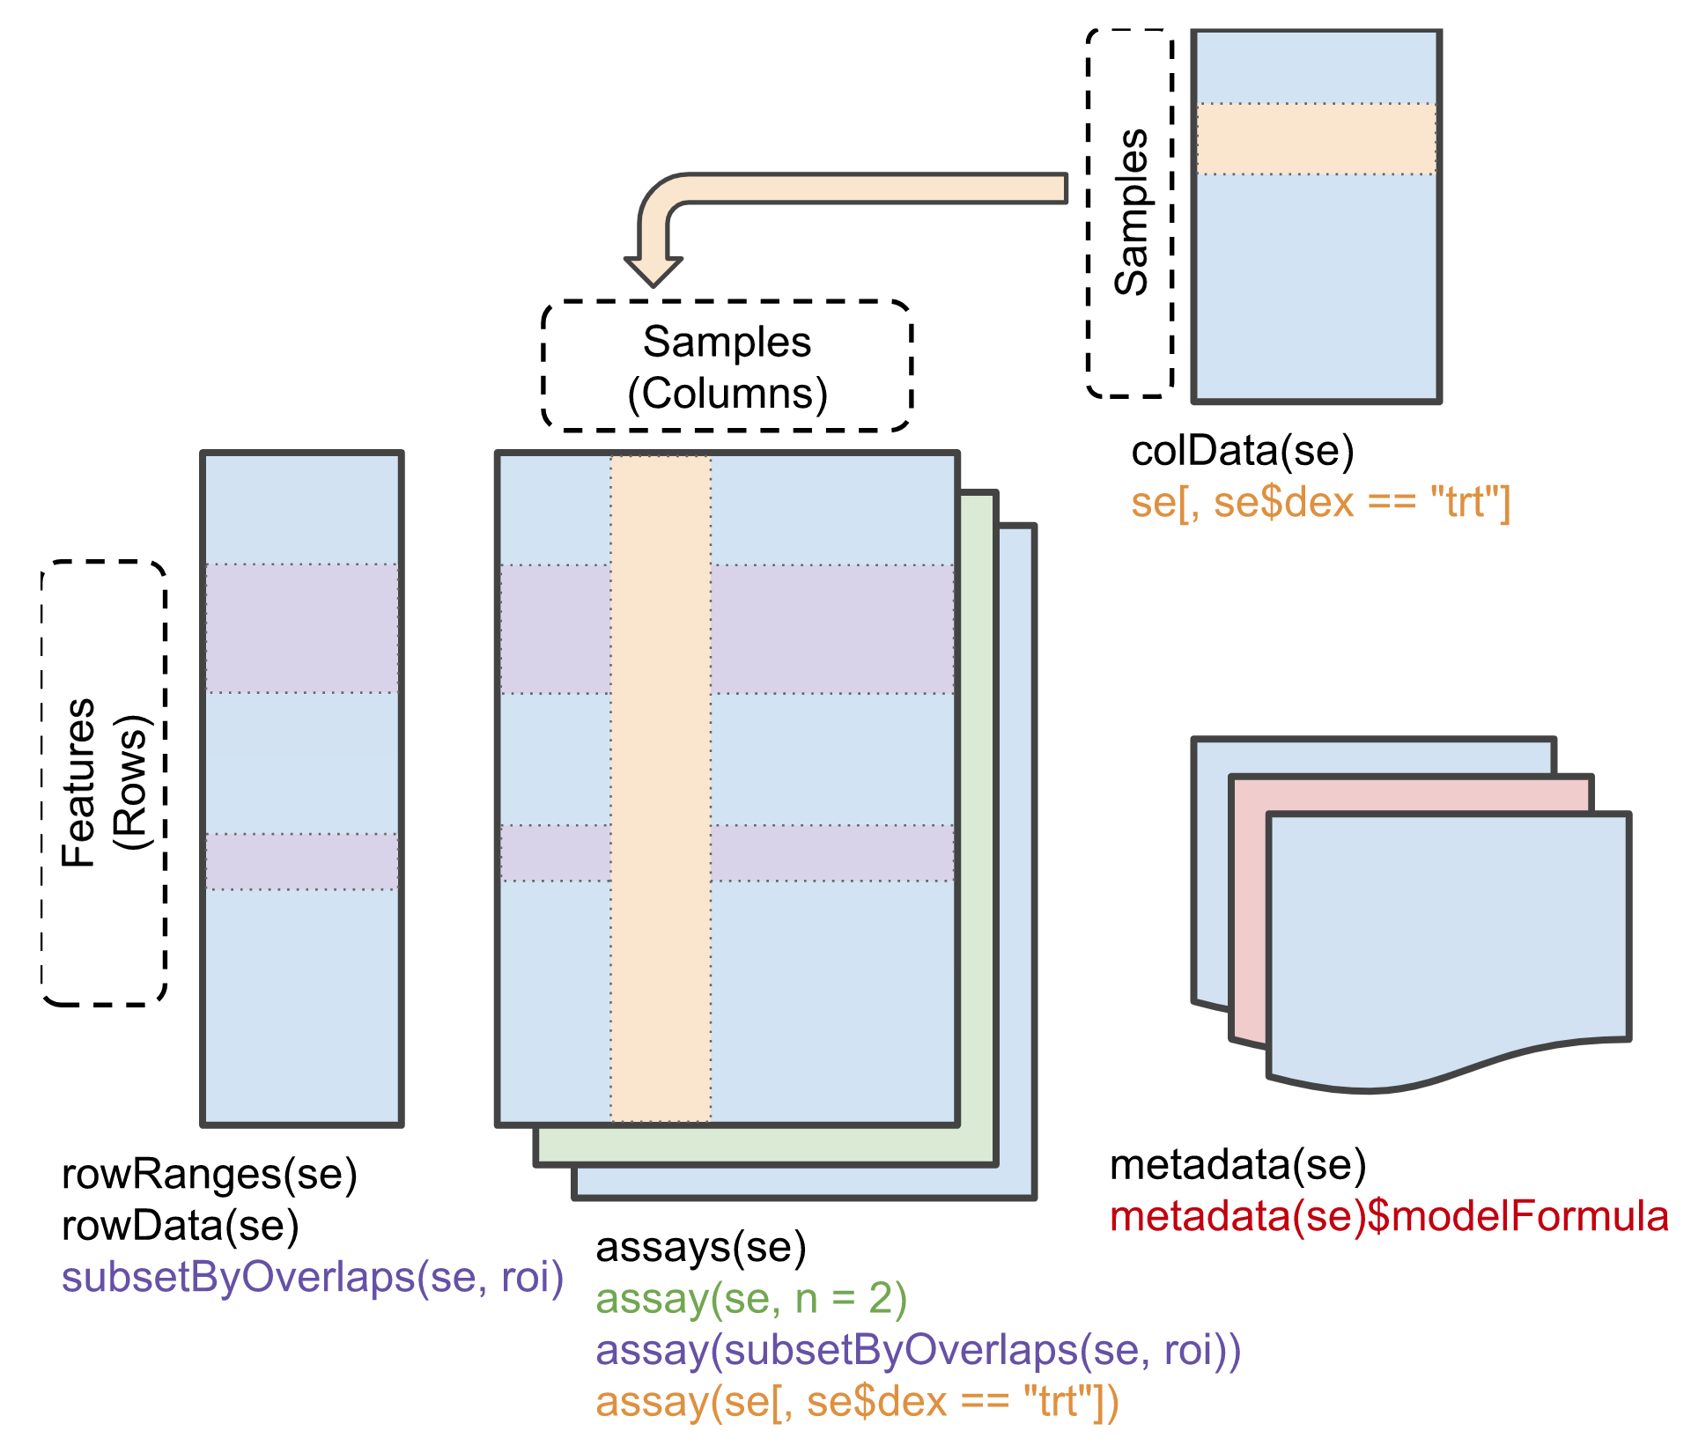
Bioconductor essentials
SummarizedExperiment
Notes:
I would like to expand these observations to in vivo data. I also want to check what happens in terms of transcriptional dynamics in cells where Cyclin O, a key non-canonical cyclin involved in MCC diff., is knocked-out.

Slide 14
Bioconductor essentials
SummarizedExperiment
Essentially: a list of assays (n measurements x m features), with enriched information regarding each measurement and each feature.
SummarizedExperiment(
assays = list(counts = matrix(runif(15), nrow = 5)),
rowRanges = granges,
colData = data.frame(
sample = c('sample1', 'sample2', 'sample3’),
sex = c('m', 'm', 'f’)
),
metadata = list(name = 'randomExp’)
)
Notes:
I would like to expand these observations to in vivo data. I also want to check what happens in terms of transcriptional dynamics in cells where Cyclin O, a key non-canonical cyclin involved in MCC diff., is knocked-out.

Slide 15
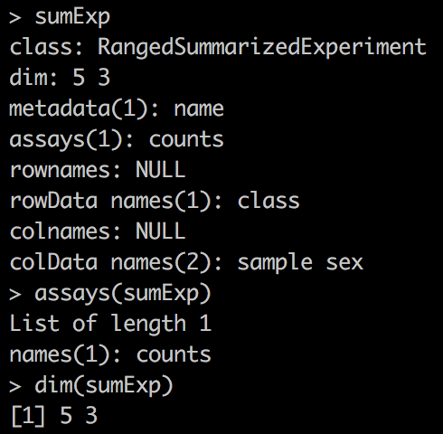
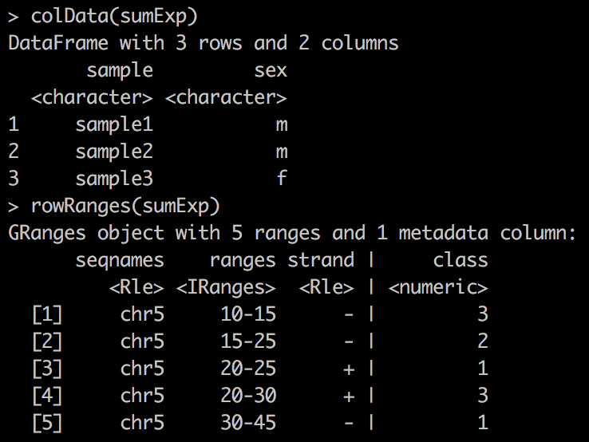
Bioconductor essentials
SummarizedExperiment
Essentially: a list of assays (n measurements x m features), with enriched information regarding each measurement and each feature.
Notes:
I would like to expand these observations to in vivo data. I also want to check what happens in terms of transcriptional dynamics in cells where Cyclin O, a key non-canonical cyclin involved in MCC diff., is knocked-out.

Slide 16
Bioconductor essentials
SingleCellExperiment
A SingleCellExperiment is a SummarizedExperiment, where each column represents a cell and each row represents a gene.
Notes:
I would like to expand these observations to in vivo data. I also want to check what happens in terms of transcriptional dynamics in cells where Cyclin O, a key non-canonical cyclin involved in MCC diff., is knocked-out.

Slide 17
Bioconductor essentials
SingleCellExperiment
A SingleCellExperiment is a SummarizedExperiment, where each column represents a cell and each row represents a gene.
Assays can either be raw UMI counts, normalized counts, or any other cell/gene estimate, e.g. splice/unspliced ratio, velocity metrics, etc…
Notes:
I would like to expand these observations to in vivo data. I also want to check what happens in terms of transcriptional dynamics in cells where Cyclin O, a key non-canonical cyclin involved in MCC diff., is knocked-out.

Slide 18
Bioconductor essentials
SingleCellExperiment
SingleCellExperiment objects also contain essential information for single-cell studies: cell embeddings in lower dimensional spaces (e.g. PCA, tSNE, UMAP, …)
Notes:
I would like to expand these observations to in vivo data. I also want to check what happens in terms of transcriptional dynamics in cells where Cyclin O, a key non-canonical cyclin involved in MCC diff., is knocked-out.

Slide 19
Bioconductor essentials
SingleCellExperiment
SingleCellExperiment objects also contain essential information for single-cell studies: cell embeddings in lower dimensional spaces (e.g. PCA, tSNE, UMAP, …)
For a n cells x g genes Summarized Experiment, cell embeddings are matrices with n rows (each row describing an individual cell) and k columns. k ranges from 2 (e.g. for 2D UMAP embedding) to typically 50 (e.g. 50 principal components)
Notes:
I would like to expand these observations to in vivo data. I also want to check what happens in terms of transcriptional dynamics in cells where Cyclin O, a key non-canonical cyclin involved in MCC diff., is knocked-out.

Slide 20
Bioconductor essentials
SingleCellExperiment
SingleCellExperiment objects also contain essential information for single-cell studies: cell embeddings in lower dimensional spaces (e.g. PCA, tSNE, UMAP, …)
For a n cells x g genes Summarized Experiment, cell embeddings are matrices with n rows (each row describing an individual cell) and k columns. k ranges from 2 (e.g. for 2D UMAP embedding) to typically 50 (e.g. 50 principal components)
These embeddings are generally used in two cases:
Data visualization (e.g. UMAP embedding)
Data dimensionality reduction to allow faster data analysis
Notes:
I would like to expand these observations to in vivo data. I also want to check what happens in terms of transcriptional dynamics in cells where Cyclin O, a key non-canonical cyclin involved in MCC diff., is knocked-out.

Slide 21
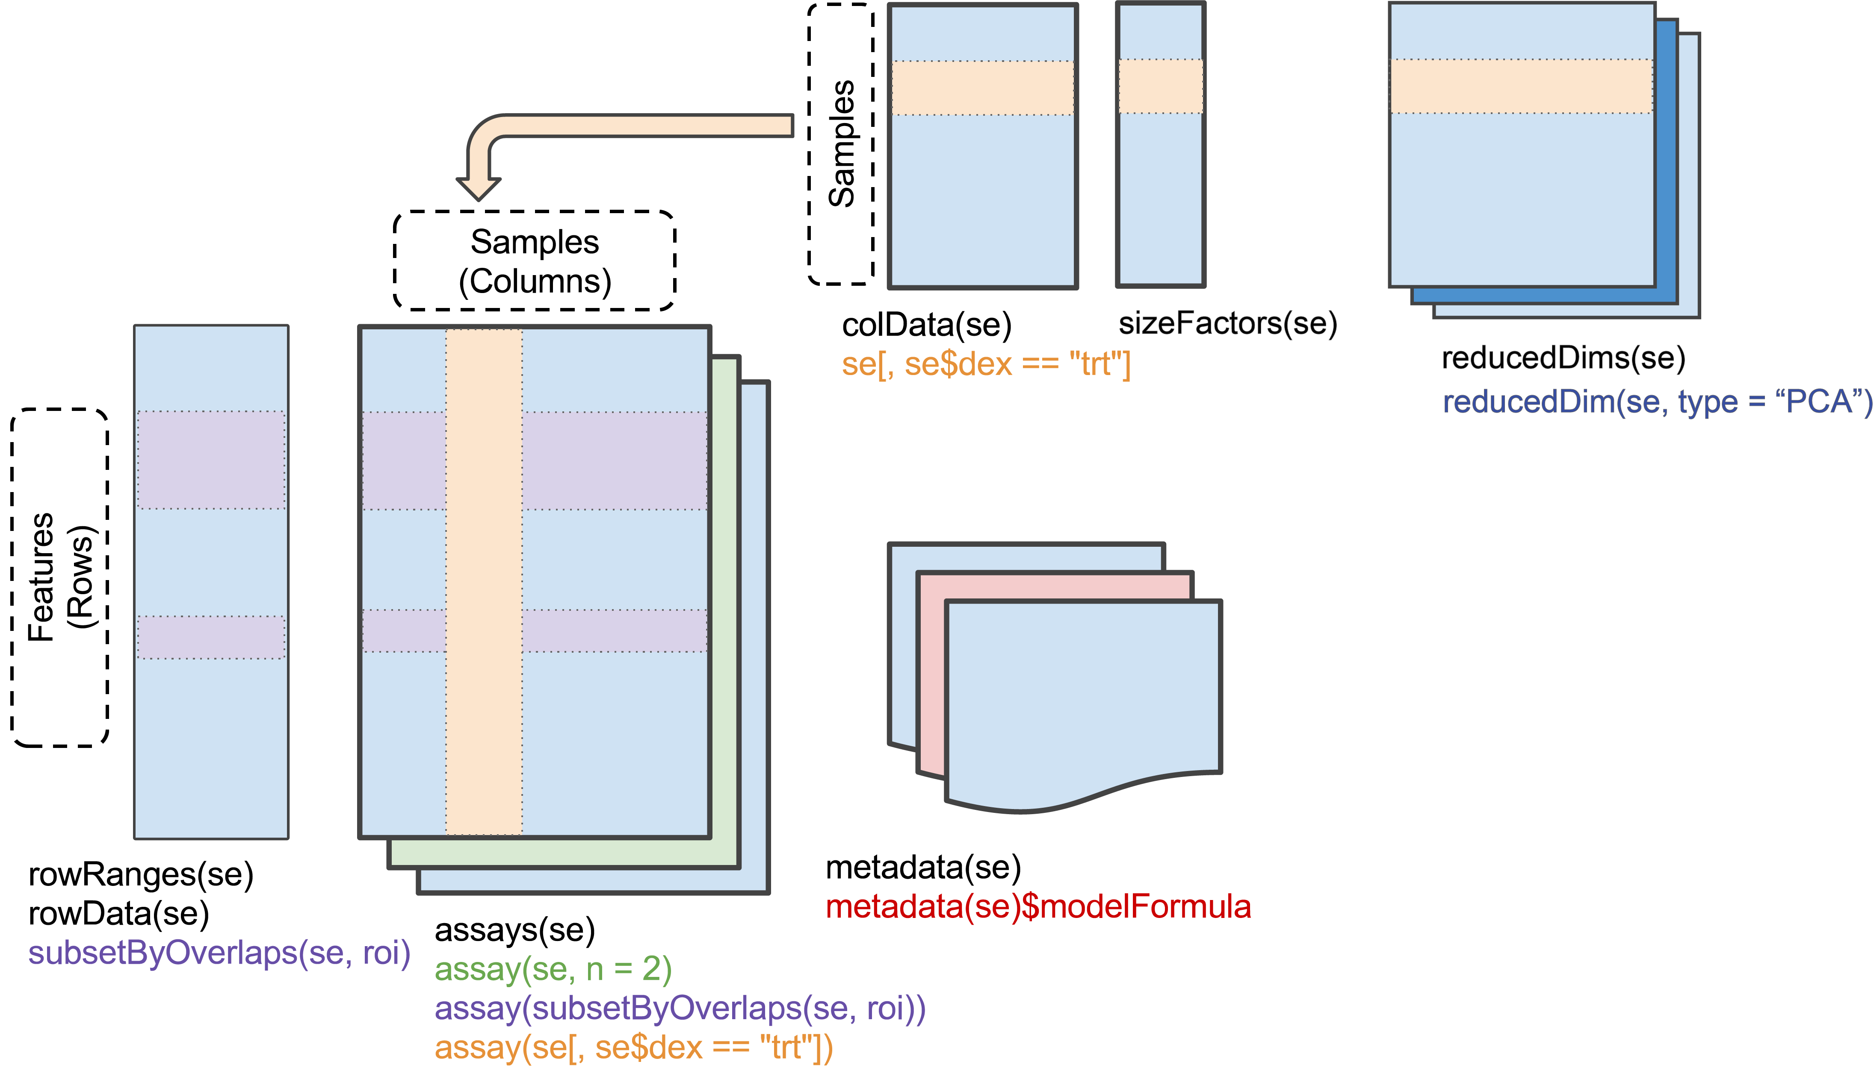
Bioconductor essentials
SingleCellExperiment
SingleCellExperiment objects also contain essential information for single-cell studies: cell embeddings in lower dimensional spaces (e.g. PCA, tSNE, UMAP, …)
Notes:
I would like to expand these observations to in vivo data. I also want to check what happens in terms of transcriptional dynamics in cells where Cyclin O, a key non-canonical cyclin involved in MCC diff., is knocked-out.

Slide 22
Questions?
Notes:
I would like to expand these observations to in vivo data. I also want to check what happens in terms of transcriptional dynamics in cells where Cyclin O, a key non-canonical cyclin involved in MCC diff., is knocked-out.

